Slide 1

SIGN LANGUAGE RECOGNITION USING MACHINE LEARNING
MAJOR PROJECT FINAL REVIEW
In
ELECTRONICS AND COMMUNICATION ENGINEERING
by
D. Saiprasad (B171034)
P.Nagababu(B171119)
Under the guidance of
MD. Arif Ali Sir (Asst. Professor )

Slide 2
CONTENTS
Introduction
Motivation
Proposed Methodology
Software and Modules
Dataset
Testing and Result
Conclusion
Future Scope
References

Slide 3
INTODUCTION
Sign language is the only tool of communication for the person who is not able to
speak and hear anything.
Sign language is a boon for the physically challenged people to express their thoughts and emotion.
In this work, a novel scheme of sign language recognition has been proposed for identifying the alphabets and gestures in sign language.
With the help of MediaPipe and Image classifier we can detect the signs and give the respective text output.

Slide 4
MOTIVATION
The 2011 Indian census cites roughly 1.3 million people with “hearingimpairment”. In contrast to that numbers from India’s National Association of the Deaf estimates that 18 million people –roughly 1 percent of Indian population are deaf. These statistics formed the motivation for our project. As these speech impairment and deaf people need a proper channel to communicate with normal people there is a need for a system . Not all normal people can understand sign language of impaired people.project hence is aimed at converting the sign language gestures into text that is readable for normal people.

Slide 5
What is machine Learning??
The ultimate goal of machine learning is to design algorithms that automatically help a system gather data and use that data to learn more.
Machine learning learn from experience (or to be accurate ,data) like humans do without direct programming.
Machine Learning is complex,which is why it has divided into two primary areas
Supervised Learning
Unsupervised learning

Slide 6
Continued.....
Algorithms used in Supervised learning
Random Forest
K-Nearest Neighbours
Image Classification
Decision Trees
2. Algorithms used in Unsupervised learning
K-means Clustering
Singular value decomposition

Slide 7
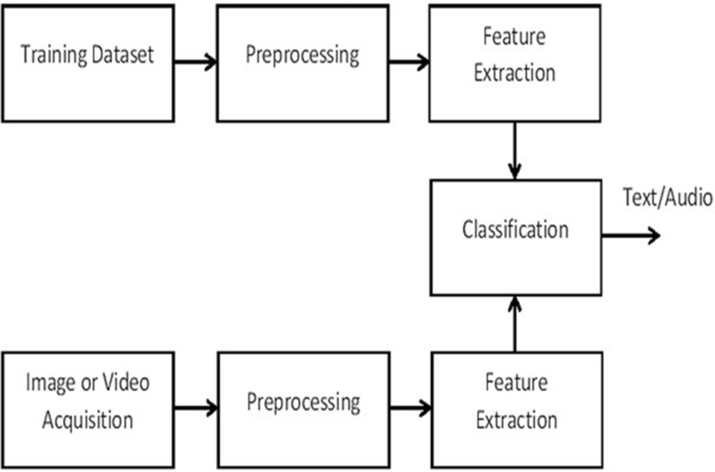
PROPOSED METHODOLOGY

Slide 8
GODKDJKKDJFKDJDJFKDDJFDKJD
SOFTWARE
PYCHARM:
1. Pycharm is the most popular IDE used for python scripting language.Pycharm offers some of the best features to its users and developers in the following aspects.
Code completion and inspection
Advance debugging

Slide 9
MEDIA PIPE
Media pipe is an open-source library that provides customizable machine learning solutions such as face and hand detection etc...
the solution for hand detection and tracking is called as MediaPipe Hands, and it employs ML to provide palm detection and a hand landmark model.
Advantages
Open Source and Free
Ready -to -Use solutions

Slide 10
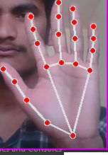
HAND TRACKING MODULE
Hand tracking module is the sub module of the mediapipe.
It is the process in which a computer uses computer vision to detect a hand from an input image and keeps focus on the hand’s movements and orientation.

Slide 11
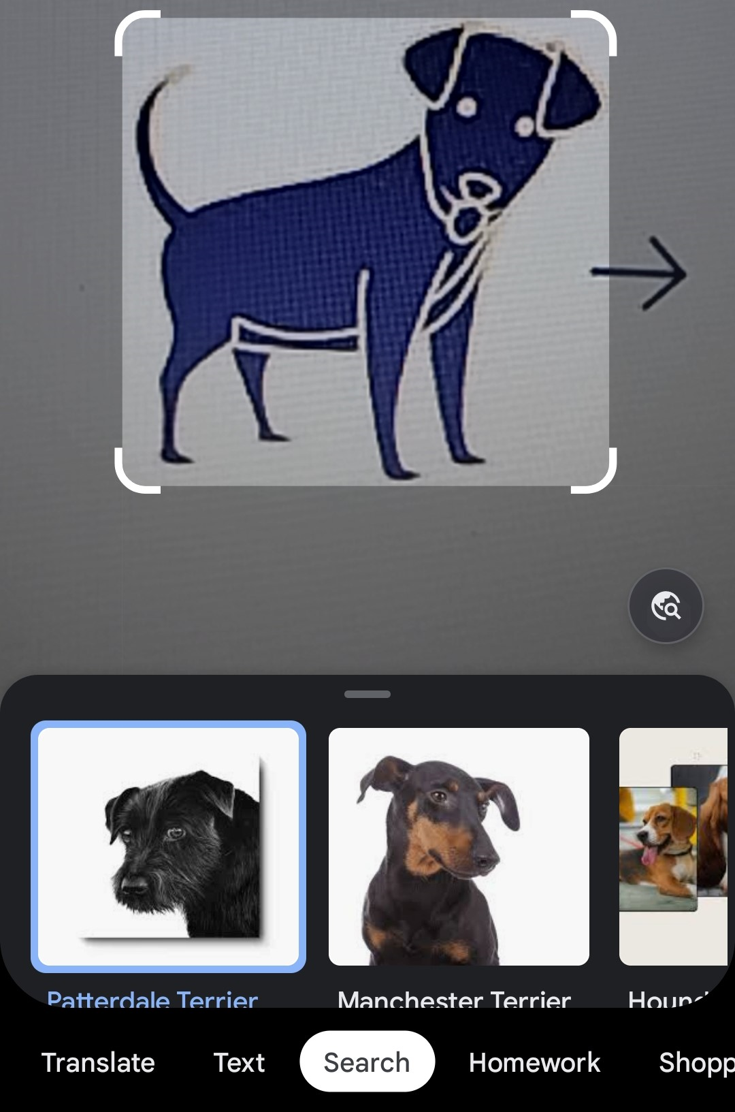
IMAGE CLASSIFIER

Slide 12
Opencv
Opencv (Open Source Computer Vision Library) is a library or programming functions mainly aimed at real-time computer vision.
Originally developed by Intel, it was later supported by Willow Garage.
OpenCV’S application areas include:
Facial recognition system
Gesture recognition
Motion understanding
Object identification

Slide 13
TENSORFLOW
Tensorflow is a free and open-source software library for dataflow and diffrentiable programming across a range of tasks. It is a symbolic math library, and is also used for machine learning applications such as neural networks. It is used for research.
FEATURES :
TensorFlow provides stable python
C APIs

Slide 14
KERAS
Keras is the open-source neural-network library written in python. It is capable of running TensorFlow Microsoft and Machine Learning.
Kearas is very powerful and useful for beginners .
Advantages
Fast Experiment
Simplicity
Less Errors

Slide 15
NUMPY
Numpy is a library for the python programing language,adding support for large,multi-dimensional arrays and matrices,along with a large collection of high-level mathematical functions to operate on these arrays.
Advantages:
Numpy performs array-oriented computing .
It performs scientific computations.

Slide 16
DATASET
For the system we have created our own dataset which consists of 18 different hand
gestures ,each gesture having 150 samples .The overall size of our dataset is 60 MB.
Dataset includes :
It includes 3 different categories
1. Alphabets
2.Numbers
3.Customized Gestures

Slide 17
Continued
Preprocessing:
Uniform aspect ratio
Understanding aspect ratios:An aspect ratio is a proportional relationship between an image's width and height. Essentially, it describes an image's shape.Aspect ratios are written as a formula of width to height, like this: For example, a square image has an aspect ratio of 1:1, since the height and width are the same.The image could be 300px × 300px and the aspect ratio would still be 1:1.

Slide 18
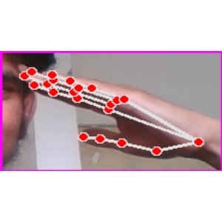
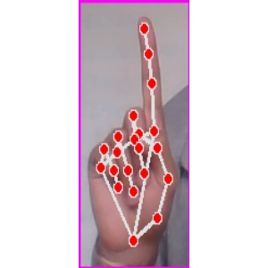
Continued..

Slide 19
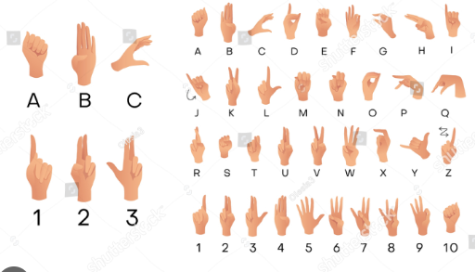
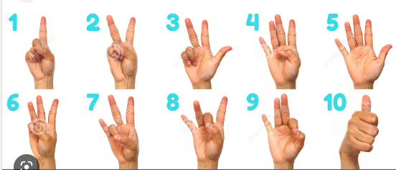
Reference signs

Slide 20
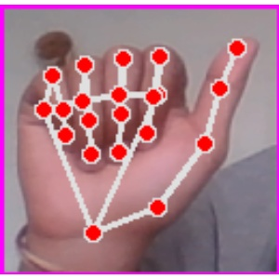
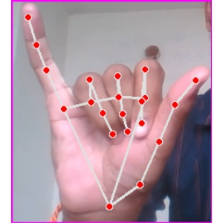
SIGNS
A
I

Slide 21
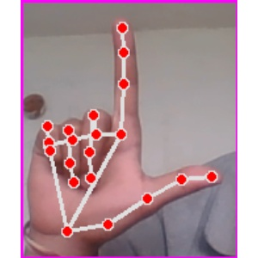
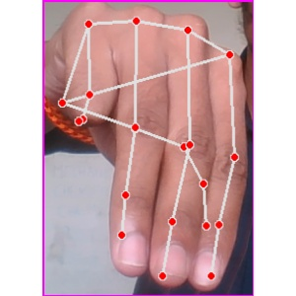
Continued...
L
M

Slide 22
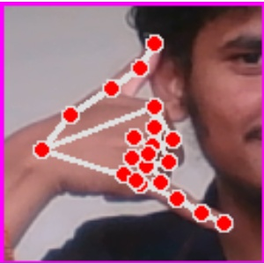
Continued...
Call
Salute

Slide 23
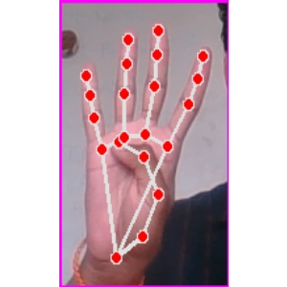
Continued...
Number 1
Number 4

Slide 24
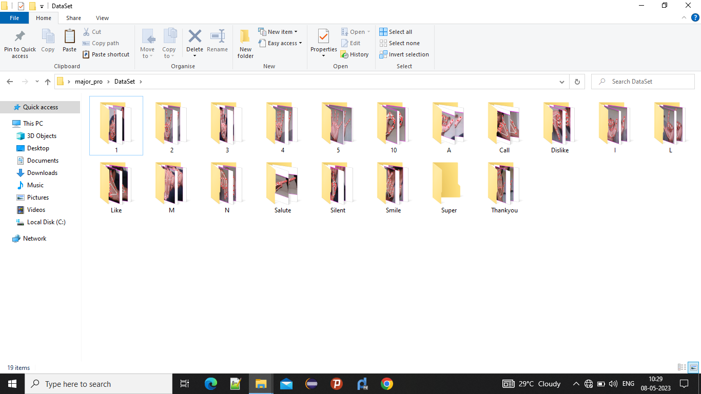
FOLDERS

Slide 25
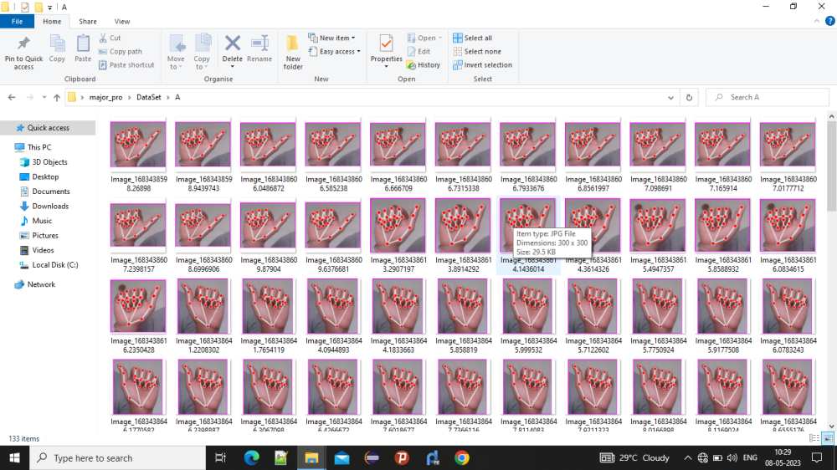
Trained Samples

Slide 26
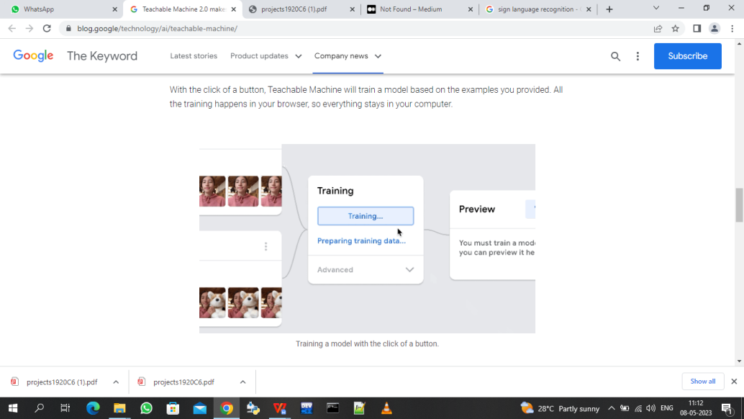
Training..

Slide 27
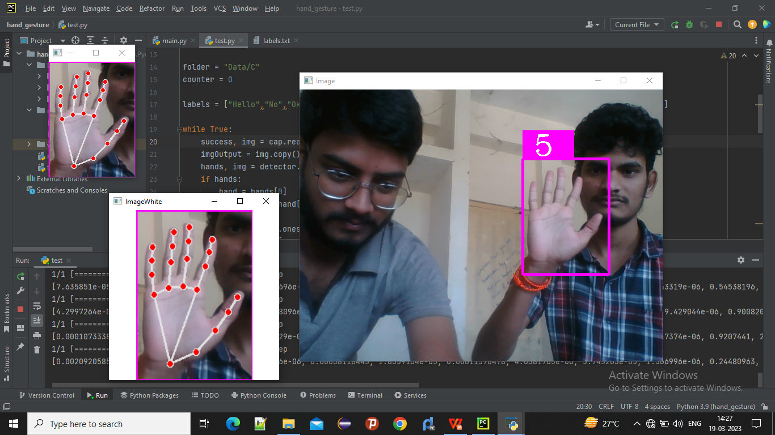
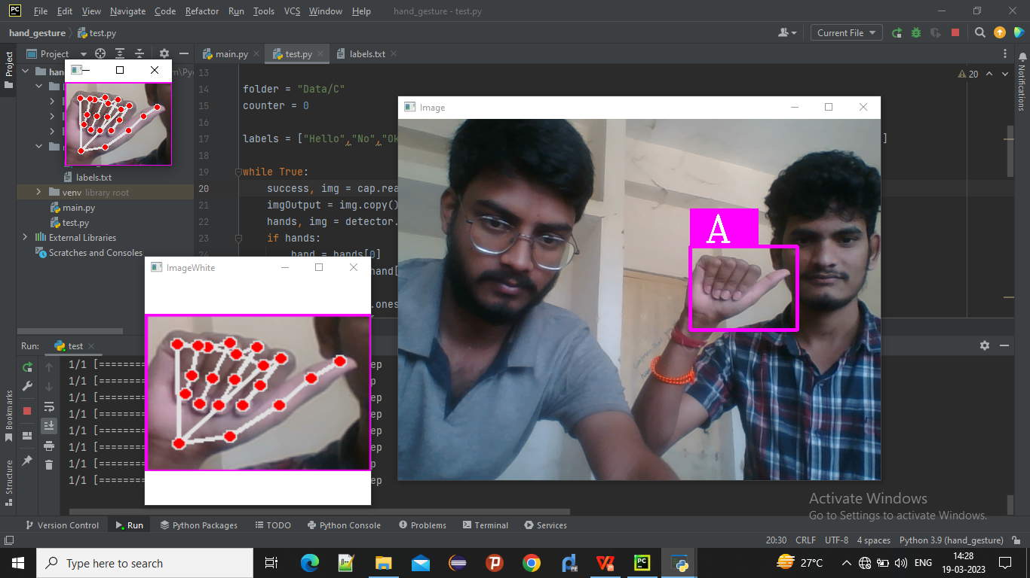
TEST RESULTS

Slide 28
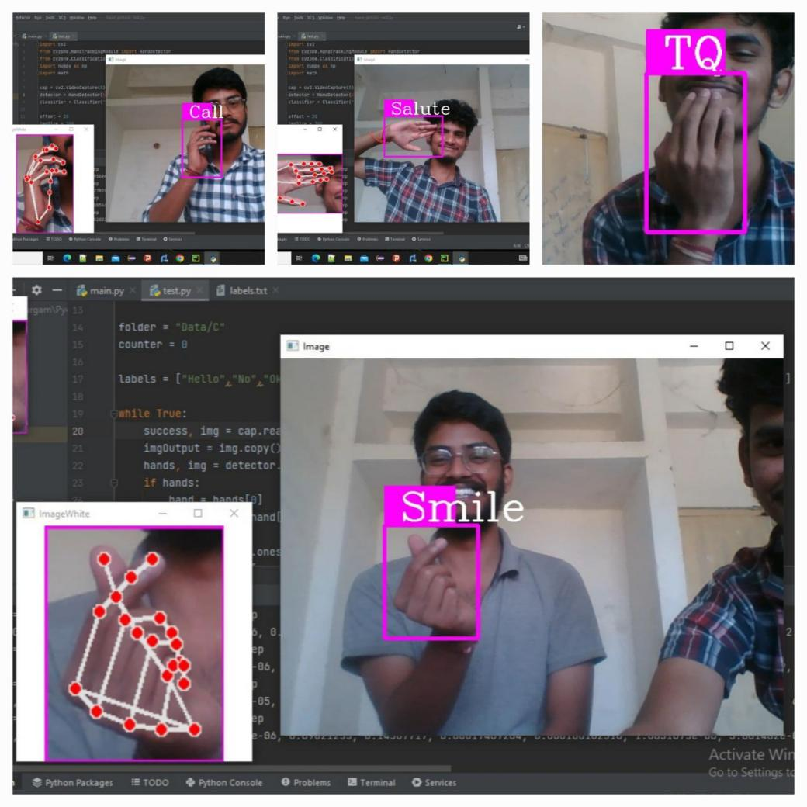
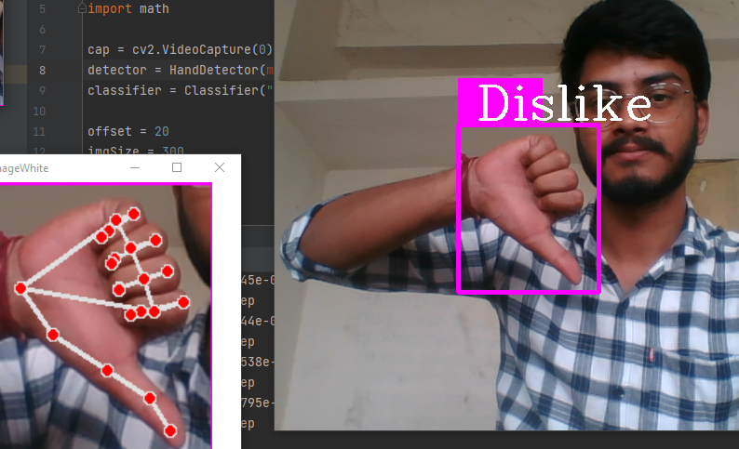
Continued......

Slide 29
Accuracy
We have taken 20 random test samples in which the trained model successfully predicted
18 samples correctly .With this model we have developed a new model with an accuracy
around 90 percentage which was better than the previous model.

Slide 30
Accuracy Comparision
Method Used | Accuracy
Glove and sensor (Previous model) | 86%
Image Classifier Algorithm (our model) | 90%

Slide 31
Conclusion
Sign language and gesture recognition system is a module which provides an easy and better communication for deaf and dumb people.
The module provides two way communications which helps in easy interaction between the normal people and disables.
The system is novel approach to ease the difficulty in communicating with those having speech and vocal disabilities.It will reduces atleast 50 percentage of the communication gap between the normal people and disables.

Slide 32
Future Scope
In this project we are working on idea for feasible communication between hearing impaired and normal person with the help of our developed model.
We can extend it by using two hands.
We can convert the given gestures into sentences in real time

Slide 33
References
Deafness and hearing loss , world health organisation.
Available: https://www.who.int/mediacentre/factsheets/fs300/en
V.N.T Truong, C.K Yang and Q.V Tran ,”A translator for sign language to text and voice”,2016 IEEE International conference paper.
“Sign Language Recognition System to Aid Deaf-Dumb People” IEEE International conference paper.

Slide 34
THANK YOU

